Slide 1
Thank you for using MakeMyTrip's services on WhatsApp. Please fill the below survey to help us serve you better.
Tuesday, January 09, 2018

Slide 2
439
Total Responses
Date Created: Thursday, December 28, 2017
Complete Responses: 439

Slide 3
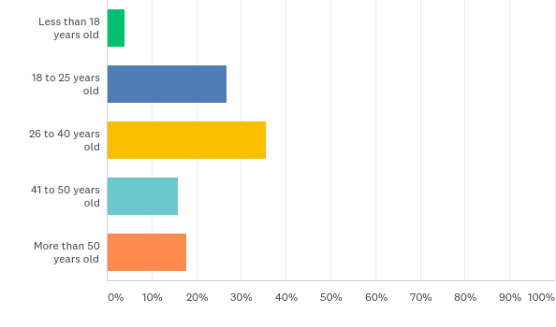
Q1: Your age...
Answered: 439 Skipped: 0

Slide 4
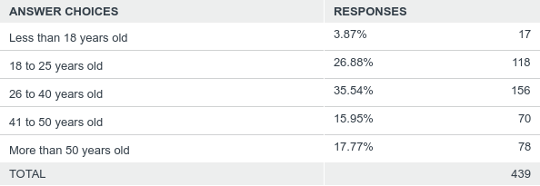
Q1: Your age...
Answered: 439 Skipped: 0

Slide 5
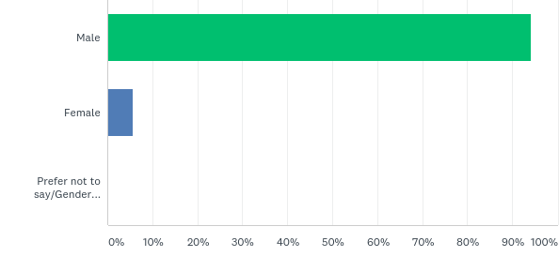
Q2: You are a...
Answered: 439 Skipped: 0

Slide 6
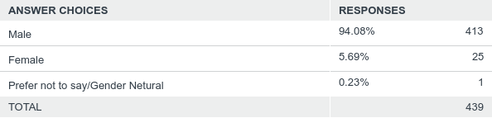
Q2: You are a...
Answered: 439 Skipped: 0

Slide 7
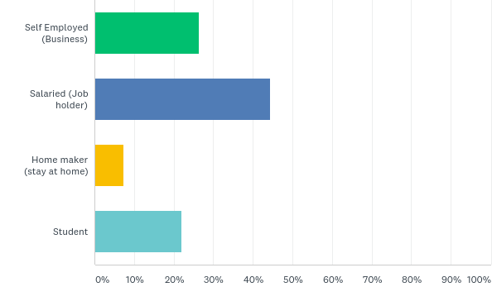
Q4: Your occupation
Answered: 439 Skipped: 0

Slide 8
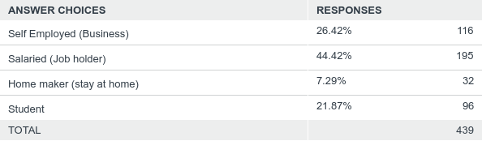
Q4: Your occupation
Answered: 439 Skipped: 0

Slide 9
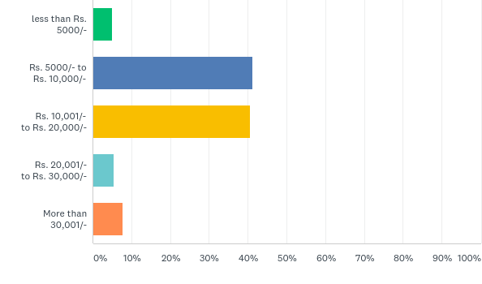
Q6: What is the price range of your mobile phone?
Answered: 439 Skipped: 0

Slide 10
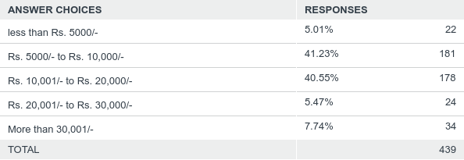
Q6: What is the price range of your mobile phone?
Answered: 439 Skipped: 0

Slide 11
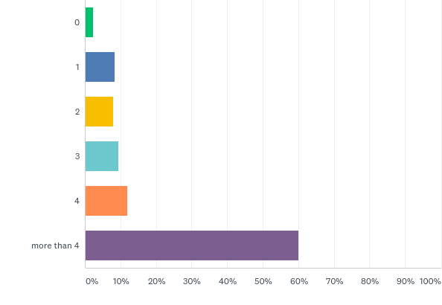
Q7: How many times do you travel in a year?
Answered: 439 Skipped: 0

Slide 12
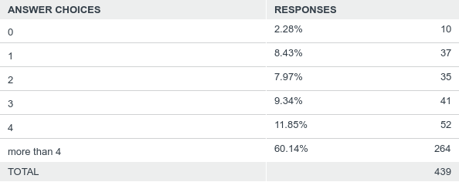
Q7: How many times do you travel in a year?
Answered: 439 Skipped: 0

Slide 13
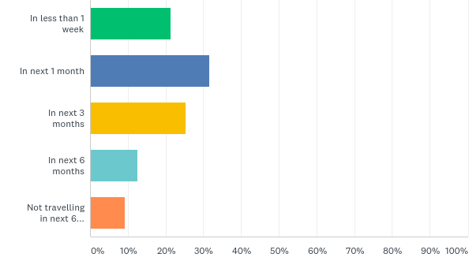
Q8: When do you plan to travel next?
Answered: 439 Skipped: 0

Slide 14
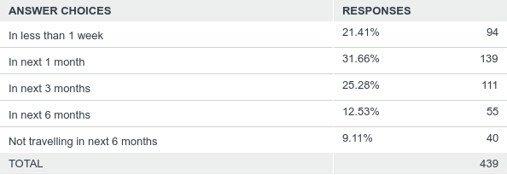
Q8: When do you plan to travel next?
Answered: 439 Skipped: 0

Slide 15
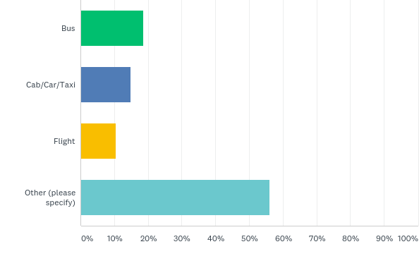
Q9: You mostly travel by...
Answered: 439 Skipped: 0

Slide 16
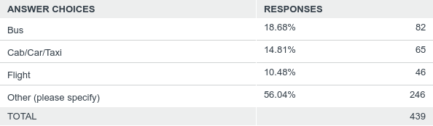
Q9: You mostly travel by...
Answered: 439 Skipped: 0

Slide 17
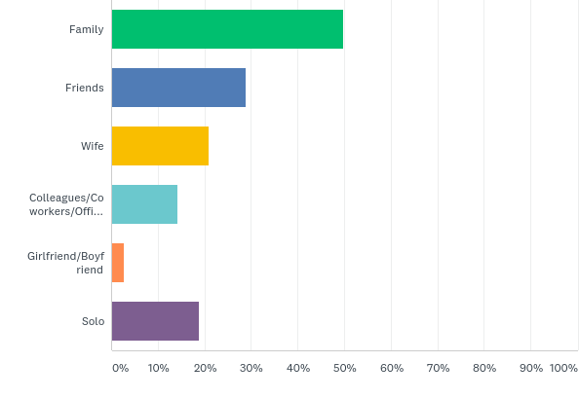
Q10: Whom do you normally travel with? (tick all that apply)
Answered: 439 Skipped: 0

Slide 18
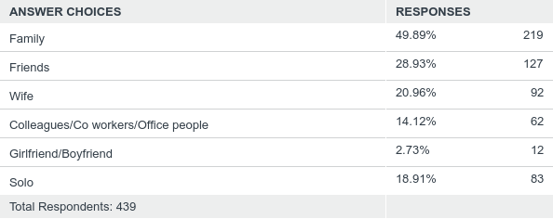
Q10: Whom do you normally travel with? (tick all that apply)
Answered: 439 Skipped: 0

Slide 19
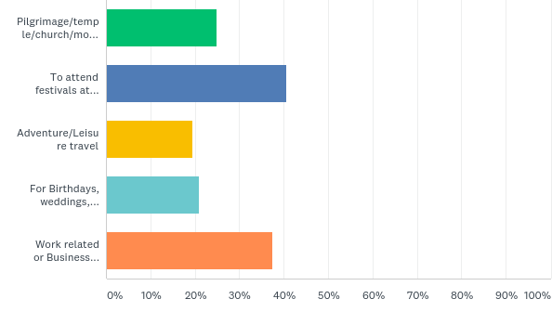
Q11: The most common reason for your travel/trip (tick all that apply)
Answered: 439 Skipped: 0

Slide 20
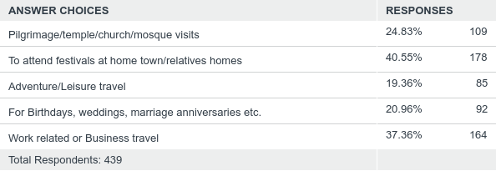
Q11: The most common reason for your travel/trip (tick all that apply)
Answered: 439 Skipped: 0

Slide 21
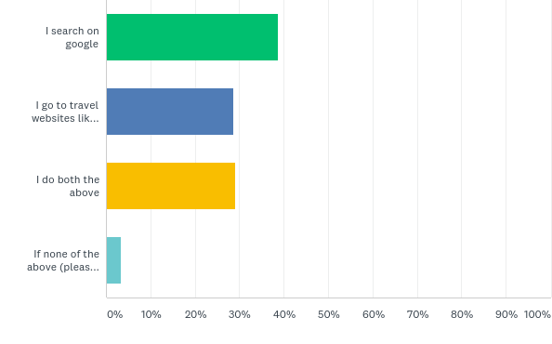
Q12: How do you search for travel related information online?
Answered: 439 Skipped: 0

Slide 22
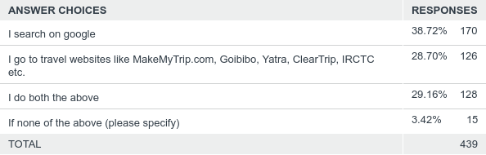
Q12: How do you search for travel related information online?
Answered: 439 Skipped: 0

Slide 23
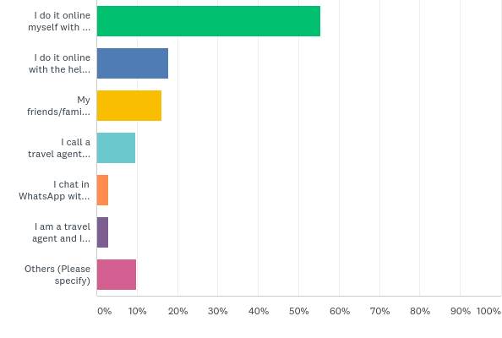
Q13: How do you book your travel tickets? (tick all that apply)
Answered: 439 Skipped: 0

Slide 24
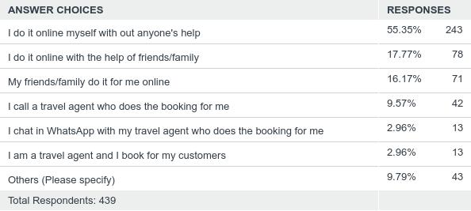
Q13: How do you book your travel tickets? (tick all that apply)
Answered: 439 Skipped: 0

Slide 25
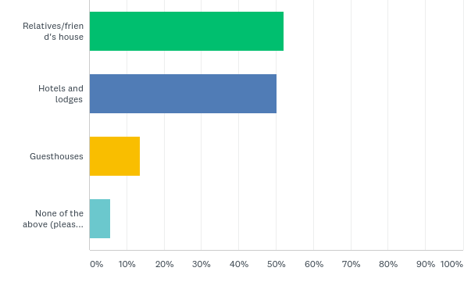
Q14: Where do you stay when you travel outside your city? (tick all that apply)
Answered: 439 Skipped: 0

Slide 26
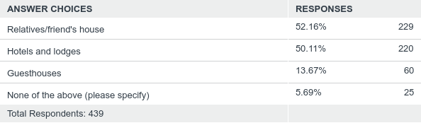
Q14: Where do you stay when you travel outside your city? (tick all that apply)
Answered: 439 Skipped: 0

Slide 27
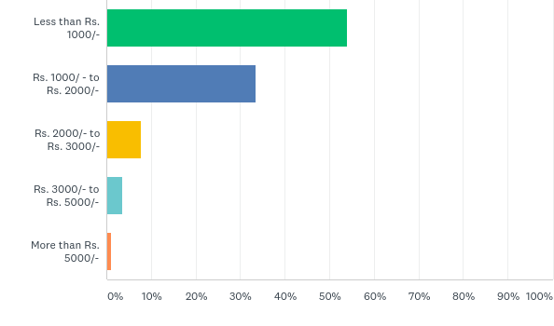
Q15: How much do you usually pay per day for a hotel room?
Answered: 439 Skipped: 0

Slide 28
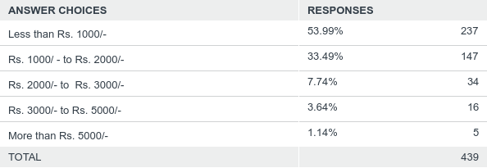
Q15: How much do you usually pay per day for a hotel room?
Answered: 439 Skipped: 0

Slide 29
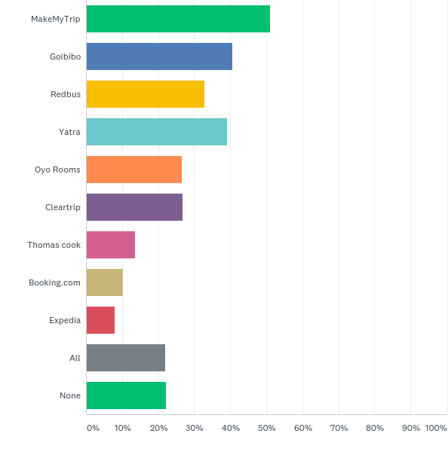
Q16: How many of these companies you have heard of? (tick all you know)
Answered: 439 Skipped: 0

Slide 30
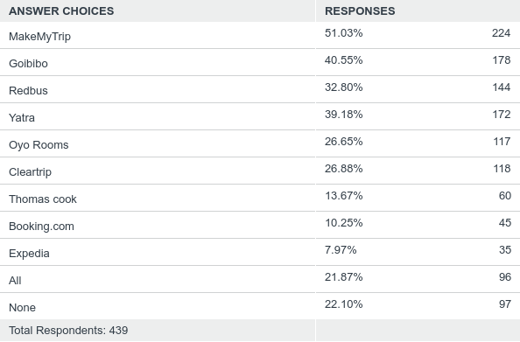
Q16: How many of these companies you have heard of? (tick all you know)
Answered: 439 Skipped: 0

Slide 31
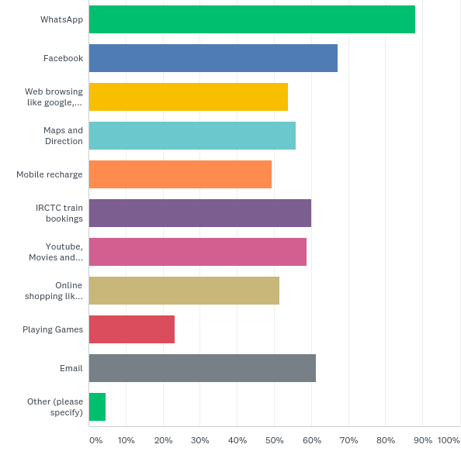
Q17: You use internet for.. (tick all that apply)
Answered: 439 Skipped: 0

Slide 32
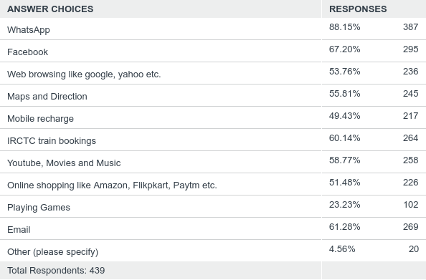
Q17: You use internet for.. (tick all that apply)
Answered: 439 Skipped: 0

Slide 33
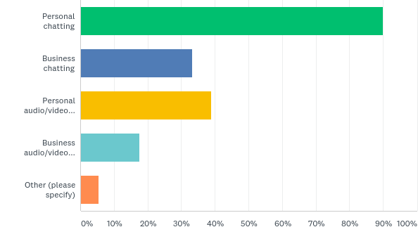
Q18: You use WhatsApp for.... (tick all that apply)
Answered: 439 Skipped: 0

Slide 34
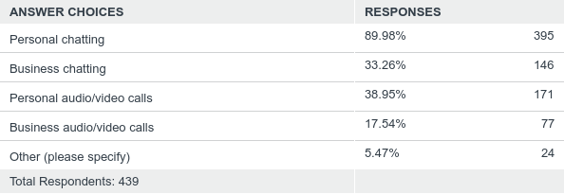
Q18: You use WhatsApp for.... (tick all that apply)
Answered: 439 Skipped: 0

Slide 35
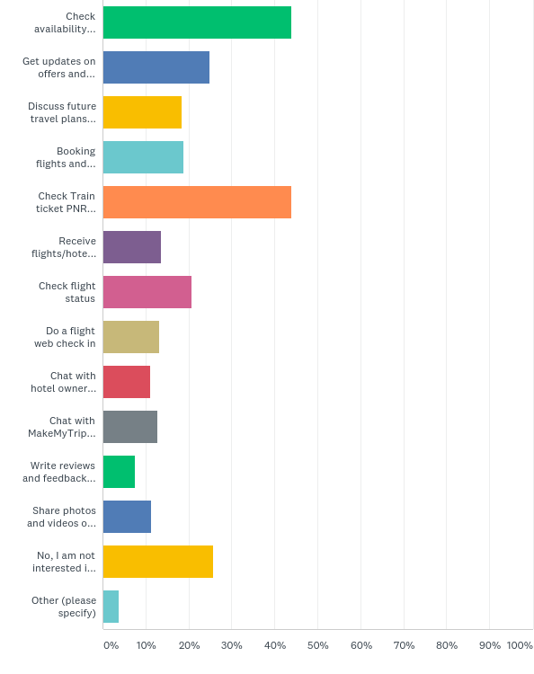
Q19: What would you like to do with MakeMyTrip via WhatsApp chat ? (tick all that apply)
Answered: 426 Skipped: 13

Slide 36
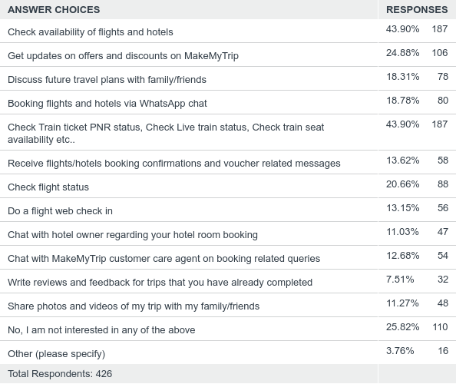
Q19: What would you like to do with MakeMyTrip via WhatsApp chat ? (tick all that apply)
Answered: 426 Skipped: 13

Slide 37
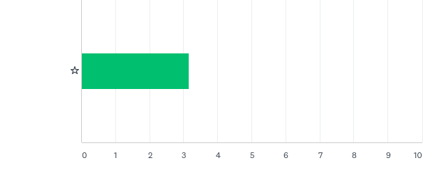
Q20: How do you rate MakeMyTrip's services on WhatsApp
Answered: 376 Skipped: 63

Slide 38

Q20: How do you rate MakeMyTrip's services on WhatsApp
Answered: 376 Skipped: 63

